Slide 1
Pie Charts and Other Chart Types
Created By: Jeffrey A. Shaffer Vice President, Unifund Adjunct Faculty, University of Cincinnati (513) 615-0001 | JeffreyShaffer@gmail.com @HighVizAbility
Notes:
Title Slide

Slide 2
Goals
By completing the course modules, students will:
Learn basic chart types
Learn how chart types encode data and how they can be used
Discuss problems with various chart types
See examples of various chart types through compare and contrast

Slide 3
Chart Types
Notes:
Note:
These examples are taken from the Glossary of The Big Book Dashboards. They are listed in alphabetical order, so they can be reordered as desired.

Slide 4
Bar Chart
encodes data using height/length of bar and shows categorical comparisons.
Notes:
A bar chart is great for showing precise quantitative comparisons encoding data with the height or length of the bar from a common baseline.

Slide 5
Box Plot
encodes data using position and height/length to show the distribution of the data.
Notes:
Box plots use position and height or length to show a distribution of the data.

Slide 6
Bullet Graph
encodes data using length/height, position and color to show actual compared to target and performance bands.
Notes:
Bullet graphs are an excellent way to show an actual value compared to a target value. It use height or length from a common baseline for the actual values and position to make the comparison to the target line. Color can be used to show performance bands so the actual value can be shown in context to the desired performance levels.

Slide 7
Choropleth Map (Shaded Map)
encodes data using color and position to show data geographically.
Notes:
A shaded map uses color to encode quantitative data (example sales by state) or categorical data (example regions of the country). Position is naturally encoded in maps as well.

Slide 8
Diverging Bar Chart
encodes data using height/length of bar diverging from a midpoint to show categorical comparisons.
Notes:
A diverging bar chart uses height or length from a baseline with the bars diverging from the center. It provides a precise quantitative comparison for each diverging segment (i.e. the blue bars compared to each other), but at the same time allows a relative comparisons of the segments as well (i.e. the blue bars versus the gray bars).

Slide 9
Dot Plot
encodes data using position to show the comparisons.
Notes:
A dot plot uses position to show a comparison. This can be from a common baseline or can simple show the dots without a common baseline to show position from each other.

Slide 10
Dot Plot with Jitter
encodes data using position to show comparisons but offsets points randomly to reduce overlap of dots.
Notes:
A variation on the dot plot using position, but also applies a technique called jitter to offset the points so they are not plotted on top of each other. The jitter is a random value, so be careful not to jitter too much.

Slide 11
Gantt Chart
encodes data using length and position to show amount of work completed in segments of time.
Notes:
A Gantt chart uses length or height and position to show when one thing ends and another begins.

Slide 12
Heat Map
encodes a data table using color to highlight the differences in the table without numbers.
Notes:
A heat map encodes data using color to highlight the difference in a table without using numbers.

Slide 13
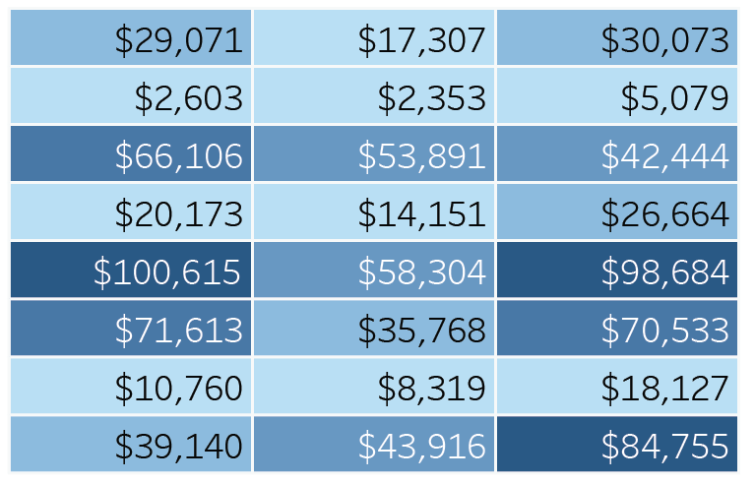
Highlight Table
encodes a data table using color to highlight the differences in the table numbers.
Notes:
A highlight table is simple a table of numbers that add color to highlight the differences in the values in the table.

Slide 14
Histogram
encodes data using height and shows a distribution.
Notes:
A histogram uses height to show the distribution of data. The bars are typically plotted close to each other and is not typically rotated.

Slide 15
Line Chart
encodes data using position and often shows trend over time.
Notes:
A line chart encodes data using position and is a good chart to show trends over time. It is best to keep the time series on the x-axis (not rotating) and having the oldest time period on the left going to the newest time period on the right.

Slide 16
Lollipop Chart
encodes data using height or length of bar and shows categorical comparisons.
Notes:
A lollipop chart is a variation of a bar chart, using height or length from a common baseline to allow for a precise quantitative comparison.

Slide 17
Scatter Plot
encodes data using position to show the relationship between two variables. Size can also be used to show a secondary comparison.
Notes:
A scatter plot uses postion to show the relationship between two variables, typically measures that are plotted on a quantitative scale. An additional measure can be encoded using size.

Slide 18
Slopegraph
encodes data using position to show quantitative comparison or rank, typically between two time periods.
Notes:
A Slopegraph uses position to quantitative comparisons or rank, typically between two time periods.

Slide 19
Sparkline/Sparkbar
encodes data using position (line) or height/length (bar) in a small, word-sized graphic.
Notes:
Sparklines use position and sparkbars use height or length to encode data. They are small, word-sized graphics that add context to numbers. They can be useful to show trends in the data in a very small space.

Slide 20
Stacked Bar Chart
encodes data using height or length of bar and color by segment and shows categorical and part-to-whole comparisons.
* Caution be careful not to slice stacked charts into too many segments.
Notes:
Stacked bar charts use height or length from a common baseline, with another bar plotted on top of it. Color is uses to differentiate the bars from each other and allow for a relative comparison. Notice that the bar on the bottom (the blue bars in this case) allow for a precise comparisons, but the gray bars do not.

Slide 21
Symbol Map (Dot Map)
encodes data using position to show data geographically and can also use size to show quantitative data.
Notes:
A symbol map uses dots or symbols on a map encoding data with position. Size and color can also be used to encode other data.

Slide 22
Treemap
encodes data using size and color and is useful for hierarchical data or when there are a very large number of categories to compare.
Notes:
A treemap uses size and often color to encode hierarchical data. It can also be used where there is a very large number of categories to compare that are not hierarchical.

Slide 23
Waterfall Chart
encodes data using height and often color to show increase and decrease between time periods or categories.
Notes:
A waterfall chart uses height and often color to encode data showing and increase and decrease between time periods and/or categories.

Slide 24
Bubble Chart
encodes data using size of circle to show comparisons which is difficult for making precise quantitative comparisons.
* Caution this chart type is not recommended.
Notes:
A bubble chart uses size to encode data, which can be very difficult to interpret for precise quantitative comparisons. For example, it is hard to see in many cases which circle is bigger and by how much.

Slide 25
Concentric Circles
encodes data using arc and area to show comparisons but
problematic for many reasons.
* Caution this chart type is not recommended.
Notes:
Concentric circles use arc and area to show comparisons, but they are problematic for many reasons. It’s difficult to make precise quantitative comparisons using arc and area. This can distort the comparison of the data.

Slide 26
Donut Chart
encodes data using arc and area to show a part-to-whole comparison but problematic for many reasons.
* Caution this chart type is not recommended.

Slide 27
Pie Chart
encodes data using angle, area and arc to show a part-to-whole comparison but problematic for many reasons.
* Caution this chart type is not recommended.
Notes:
Pie charts use angle, arc and area to show comparisons, but they are problematic for many reasons. It’s difficult to make precise quantitative comparisons using angle, arc and area. This can distort the comparison of the data. As we go through examples of pie charts you will notice that it is easy to see 25%, 50% and 75% in a pie chart, but much hard when encoding other values. It’s also easier to see a single slice in a pie chart or two slices when one is being compared to the other, but the more it’s slice the more difficult it becomes.

Slide 28
Word Cloud
encodes data using size of word to show comparisons which is difficult for making precise quantitative comparisons.
* Caution this chart type is not recommended.
Notes:
A word cloud uses size to encode data, which can be very difficult to interpret for precise quantitative comparisons. For example, it is hard to see in many cases which word is bigger and by how much.

Slide 29
Pie Charts

Slide 30
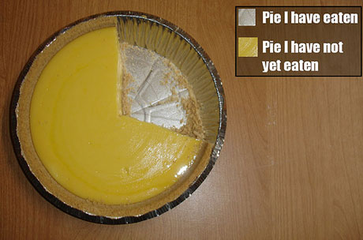
“Save the Pies for Dessert”- Stephen Few
Notes:
Let’s start off with a pie chart that I think works. Stephen Few wrote an article, “Save the Pies for Dessert”, which is part of your class readings. He likes to use this image as one of the few pie charts that work. Let’s examine the dreaded pie chart.

Slide 31
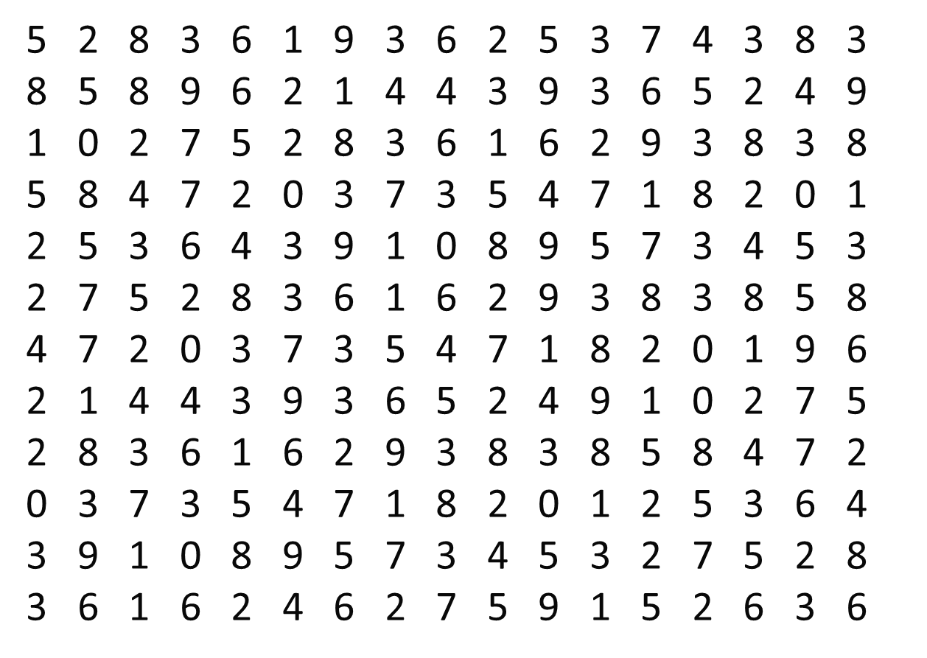
Notes:
Remember the exercise we did for counting the number of sevens? We are going to take that same data set and plot that as a pie chart.

Slide 32
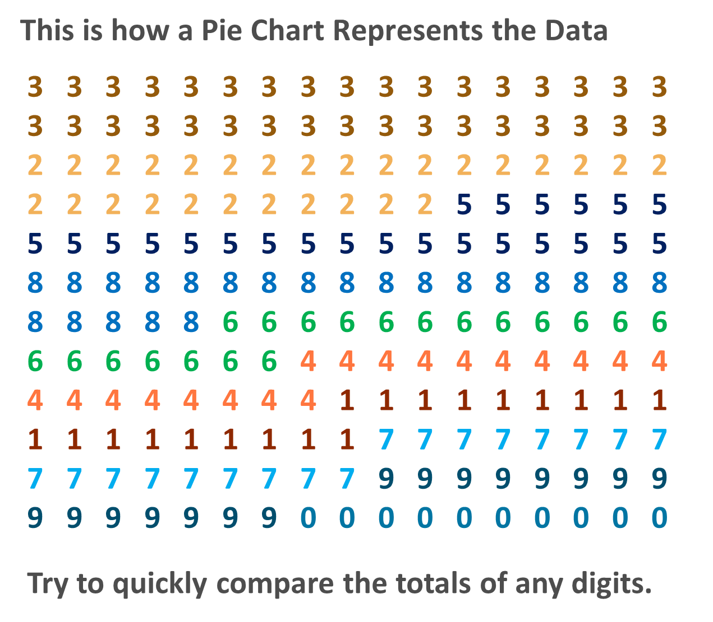
Notes:
So here’s a pie chart version of those numbers. At first glance you might be thinking to yourself, “this doesn’t look anything like a pie chart.” But this will help outline a few of the issues.

Slide 33
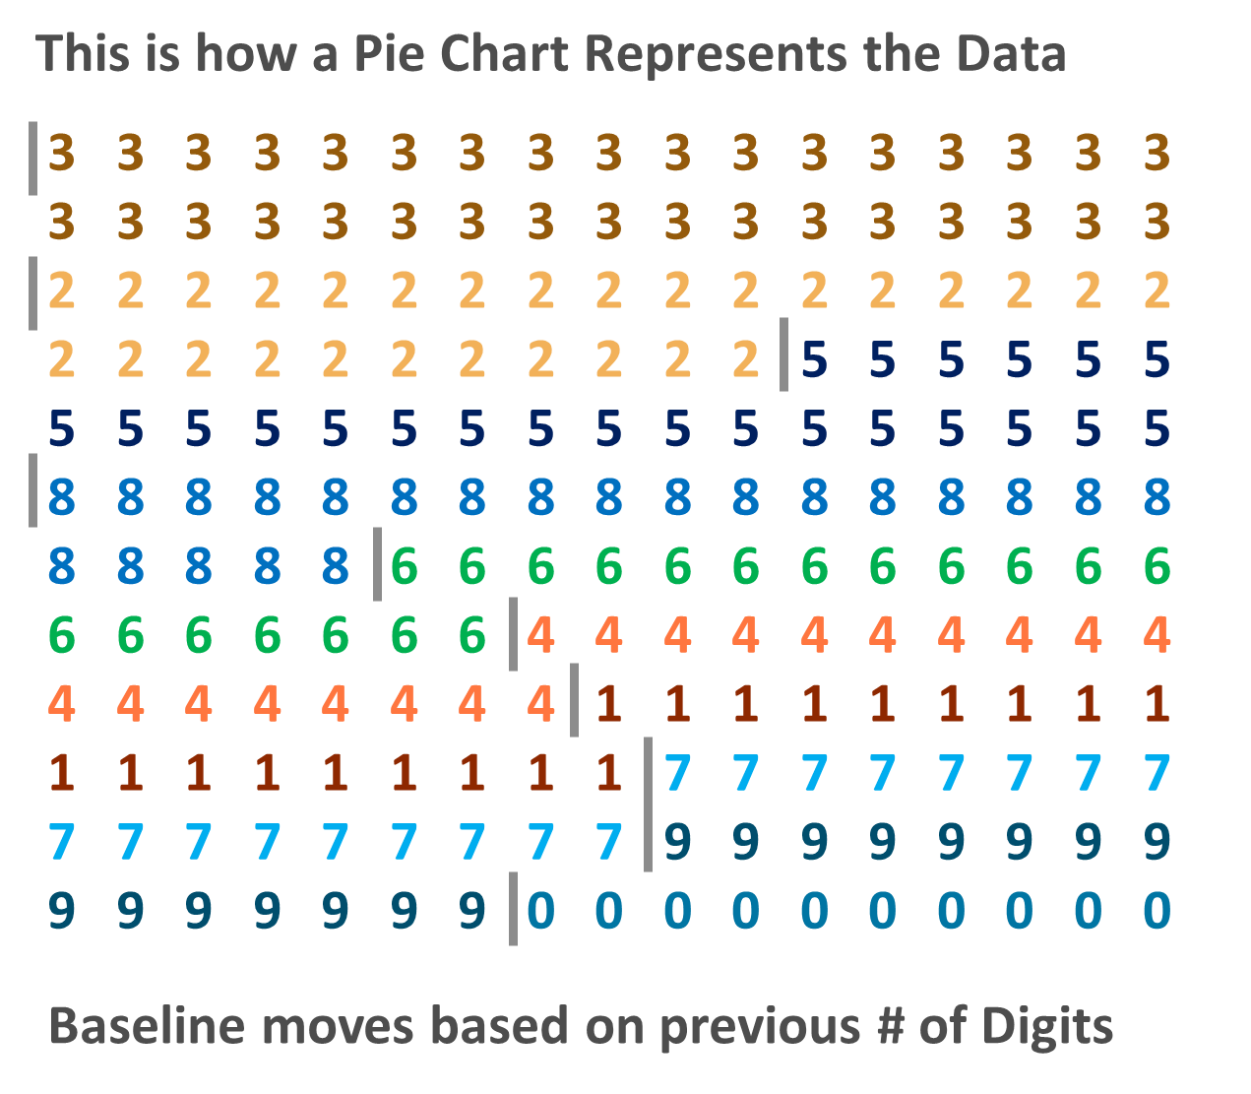
Notes:
First, there is a moving baseline from one slice to another. The fives don’t start until the twos stop and the sixes don’t start until the eights stop. Try to make a comparison of the sixes vs. the fours. Which has more and by how many? This is very difficult to do because there is no common baseline to make this comparison. In addition, we have to encode with color to tell one slice from the next. If all the slices in a pie chart were the same color then we wouldn’t be able to tell the difference between slices.
In addition to these two issues which are outlined here, there are the additional problems of interpreting angle, arc and area, which are the three ways we make visual comparisons in a pie chart. Remember we are better with height/length from a common baseline or position. We are terrible and judging angles, arcs and area for any precise and accurate comparisons.

Slide 34
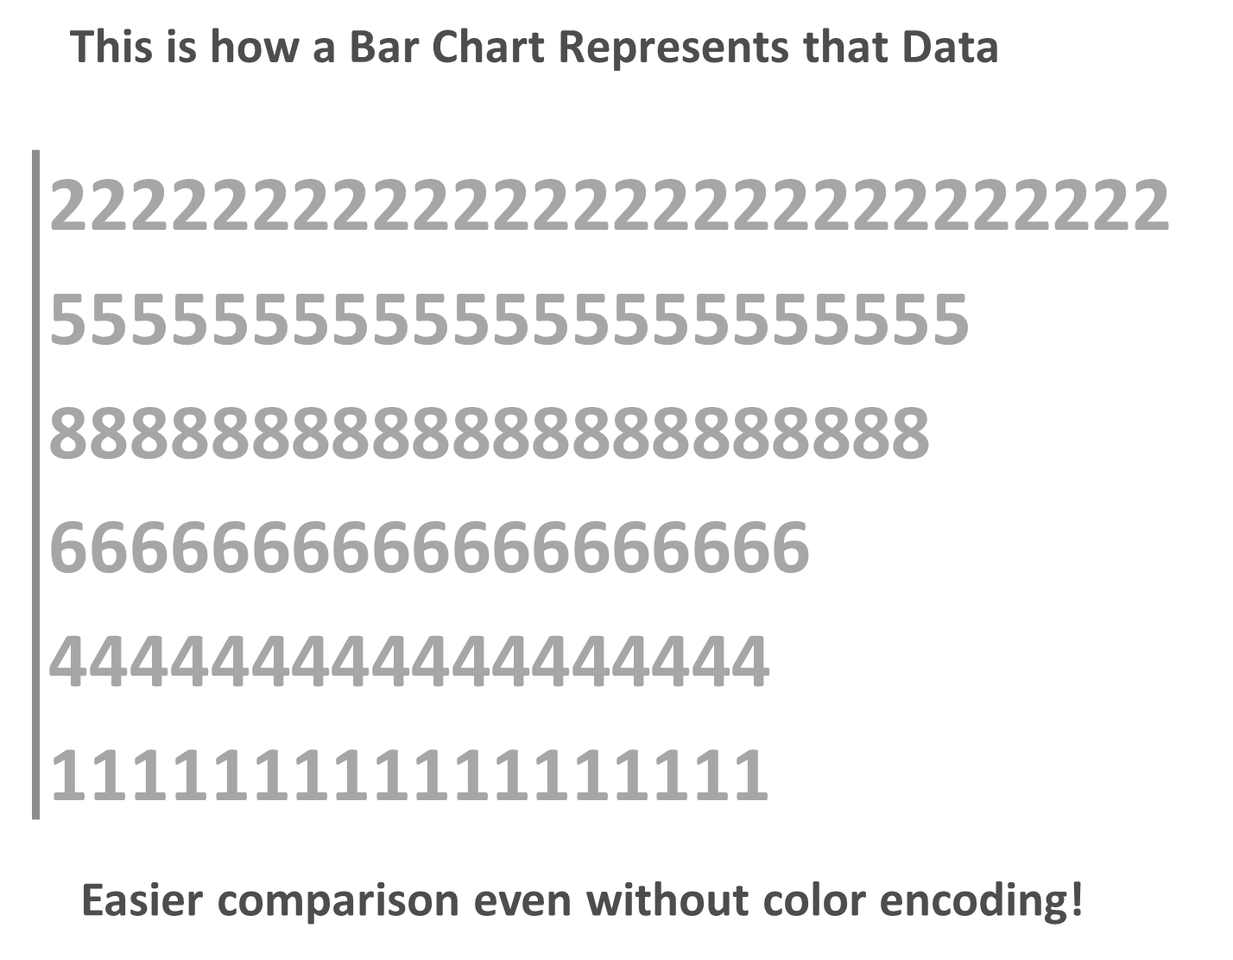
Notes:
Here is that same data as a bar chart. It’s now easy to see that there is one more six than four and we don’t have to use color at all.

Slide 35
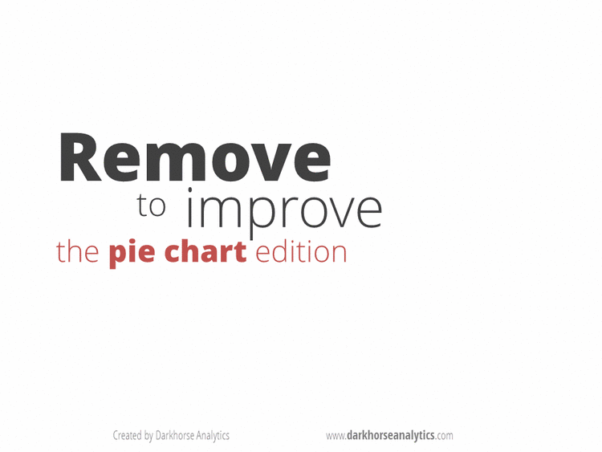
Notes:
[Animated GIF done by darkhoarseanalytics.com]

Slide 36
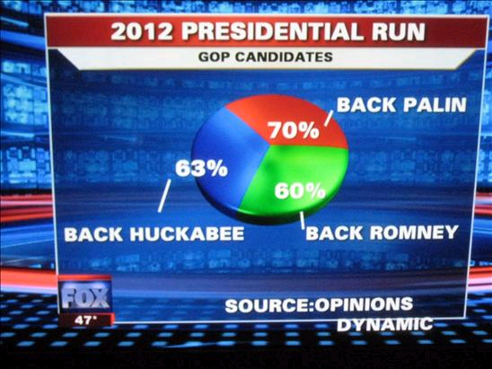
Notes:
This probably goes down as the one of the worst pie charts ever done. Fox News took and Opinion poll and decided to visualize multiple responses on a single pie chart. So the biggest issue here is that the pie chart adds up to 193%. There are also color issues, which we’ll talk about later as well as the use of 3D.

Slide 37
General Rules for Pie Charts
Don’t Use Pie Charts
If you must break Rule #1 then:
Make sure it adds up 100%
Only a few categories
Start at noon and move clockwise
Largest to Smallest Values
Add Labels for %
Avoid 3D
Keep it Simple

Slide 38
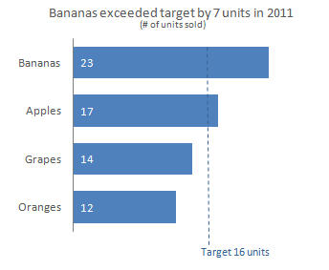
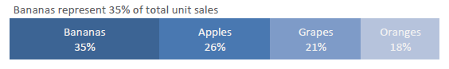
Show part-to-whole relationship (in lieu of Pie Charts)
100% Stacked Bar Chart
Notes:
Here’s one alternative to using a pie chart. The top chart shows a categorical comparison. Bananas versus apples versus grapes. It’s easy to see and make comparisons. Notice the addition of a target line, which provides information that we didn’t have before. There is now a context to the numbers in the bar chart.
The 100% stacked bar chart focuses on a single item, bananas and compares to the whole. This is a part-to-whole, with a good annotation showing that bananas represent 35% of total unit sales. Be careful with stacked-bar charts though. They have some of the same issue we discussed about the pie charts. There’s a moving baseline and it often requires encoding in color, but it does not require estimating angles and arcs.

Slide 39
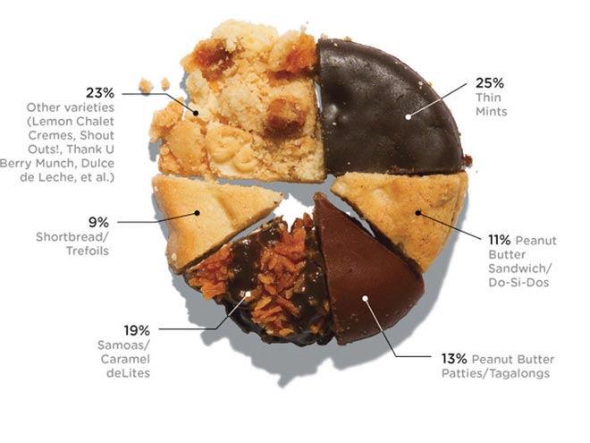
Girl Scout Cookie Sales
Photo: Celine Grouard
Source: www.wired.com/magazine/2011/08/st_datagirlscoutcookies
Notes:
Here is another pie chart that might work. It has an interesting design and might be engaging to the reader for the topic. It’s really hard to make comparisons of one cookie slice versus another, so what you could do in this case is have a small bar chart underneath that shows each cookie with the data, making it easy to see the comparison without giving up the visual design elements that might attract a reader’s attention.

Slide 40
Pie Chart of Japan
Japan
Notes:
And this one really wouldn’t work as a bar chart.

Slide 41
Common Chart Types
Bar Chart - category comparison (with target line)
Line Chart - time series data
Flow Chart – process flow (also Swimlane diagram)
Bullet Graph – actual to target
Dot Plot or Strip Plot
Sparklines
Histogram
Map
100% Stacked Bar Chart (with caution)
Scatter Plot – relationship/correlation
Box Plot – grouping with summaries
Area Chart (with caution)
Control Charts (statistical process control)
Notes:
Here’s a list of common chart types. We’ve already covered many of these, but let’s look at a few that we haven’t mentioned and that we might find useful in the data visualization toolbok.

Slide 42
Compare and Contrast

Slide 43
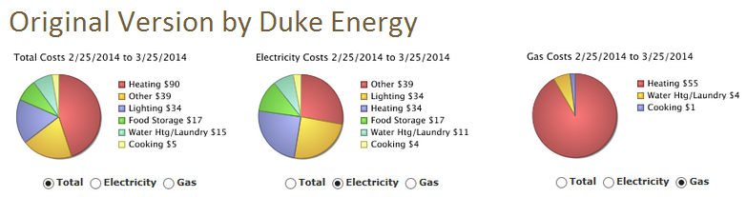
A Pie Chart Redesign
Redesigned Using a Sankey Diagram
Notes:
This is a real-world example of an energy usage report from Duke Energy. These pie charts attempt to show energy usage for Electricity, Gas and the total energy overall. Each pie chart breaks down the things that are using the energy. Notice how hard it is to make a comparison from one to the other. What’s the issue with color?
And what’s the story here?

Slide 44
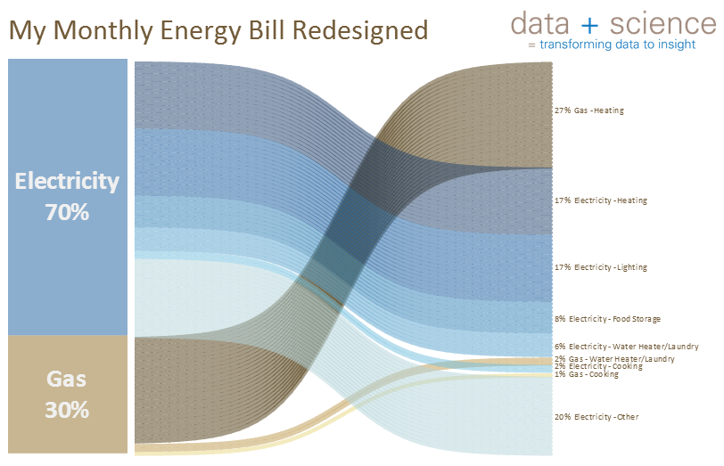
Notes:
Here is a redesign using a Sankey diagram. This type of chart is really good for showing flow through a system. For example, at a University, how many students come in as Freshman and then change majors each year, drop out or go on to graduate. In this case, the Sankey starts with the total energy of Electricity and Gas and then breaks down into the ranked categories of the usage. We see that 70% of the energy usage is electricity on the left, but it’s not until we see the breakdown on the right that it’s clear that Heating with Gas and Heating with Electricity are the top two categories. 44% of the total usage is going to Heating.

Slide 45
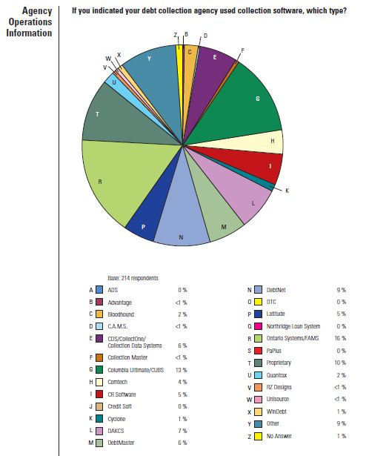
Source:
American Collectors Association
Notes:
This is a real pie chart that is showing the software packages being used by various companies. Alphabetical order is being used here, which is not useful at all. Which one is bigger, G or T, and by how much? Well first we have to go to the table and figure out G and T and then read the numbers. But that’s not a question that a reader would even want to ask. They don’t care about the letters, they want to compare the software vendors.
Let’s ask questions that a reader might want to know.
What’s the top 5?
What’s the 2nd from the top?
And the 3rd?
How fast can you answer those questions? And how accurate do you think you would be? Is it possible that you might have made a mistake?

Slide 46
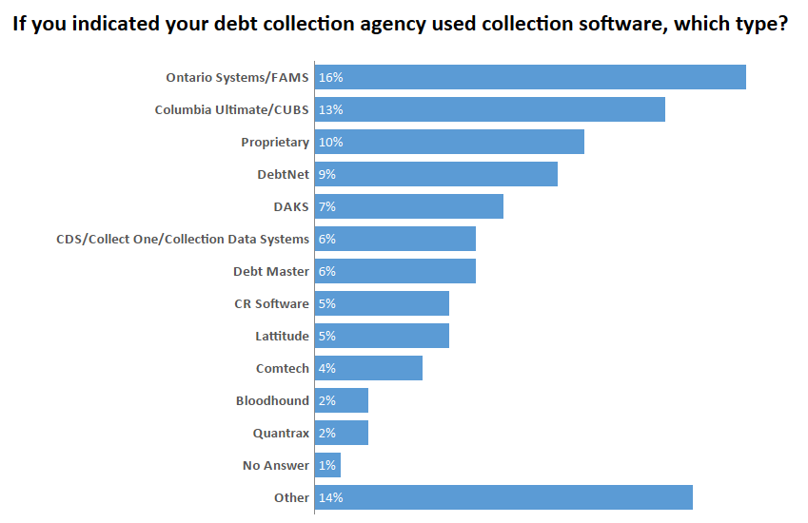
Notes:
Compare that pie chart to this one and let’s ask those same questions.
Let’s ask questions that a reader might want to know.
What’s the top 5?
What’s the 2nd from the top?
And the 3rd?
Notice that the smaller package are grouped together in “Other”. There are 26 total software vendors here. Adding an “Other” category is one way of eliminating lots of bars on a bar chart which can require the reader to scroll and make the comparisons difficult, but this only works if that information is not needed. For example, what are the bottom 5? We can’t answer that question now, because they are aggregated together.

Slide 47
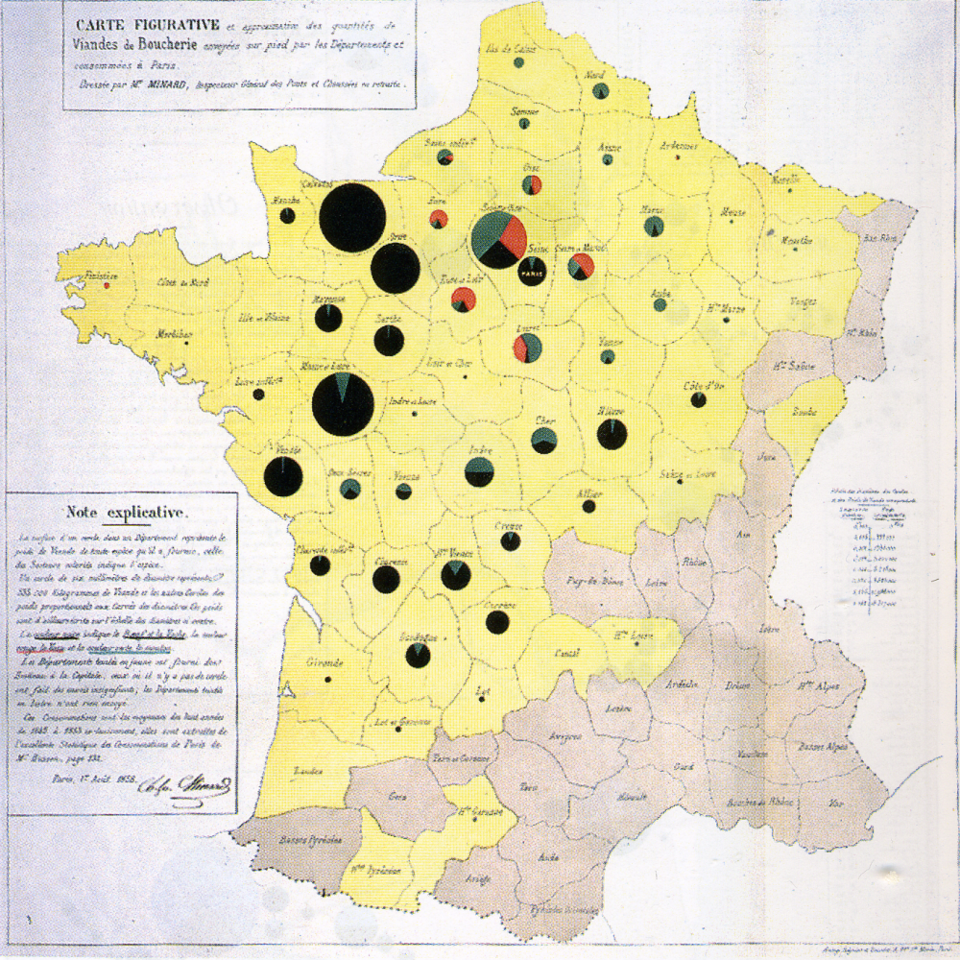
Pie Charts on a Map
Notes:
There’s often exceptions to the rules in data visualization. Even though pie charts are generally thought to be bad practice, it is generally accepted that pie charts on a map work. This is primarily due to the fact that since a map relies on 2D position for the location on the map there is no way to have a common baseline. There is simply no good solutions for visualizing a part-to-whole relationship or even a categorical comparison on a map. This map was created by Charles Joseph Minard, the same person that created Napolean’s March into Russian that we studied in Module 1. He created this one in 1858 to visualize the supply of meat to Paris, France.

Slide 48
Other Chart Types

Slide 49
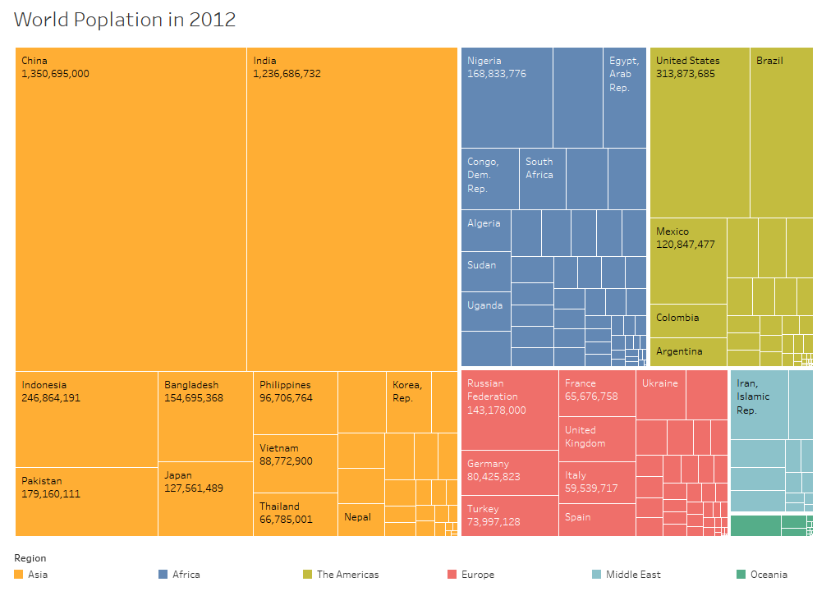
Source: https://www.dataplusscience.com/BuildingTreemaps.html
Notes:
The treemap was invented by Ben Shneidermann. The purpose of the treemap was to visualize hierarchical data on a single visualization. As an example, a hard drive on a computer. It starts with the C drive, then there is a “My Documents” folder and underneath that there might be a “Pictures” folder and a “Videos” folder and so on. This is a tree structure. The treemap visualizes that hierarchy in a single view.
This tree map shows the World Population. It’s colored by Continent and the countries are inside each continent. The treemap reads from the largest in the top left-hand corner to the smaller in the bottom right-hand corner. People often point out that it’s a rectangular pie chart, but the treemap encodes using area. Notice that the Country of India has more people than the Continent of Africa. This would be a hard comparison to show with other types of visualizations. This allows from comparisons within a node (the Countries inside one Continent), but it also allows for a comparison across nodes at different levels of detail.
The treemap can be a powerful visualization, but notice that as the rectangle get smaller they don’t have labels. This requires hovering or highlighting as an interactive feature to be useful.
Additional information about treemaps is available at https://www.dataplusscience.com/UsingTreemaps.html.

Slide 50
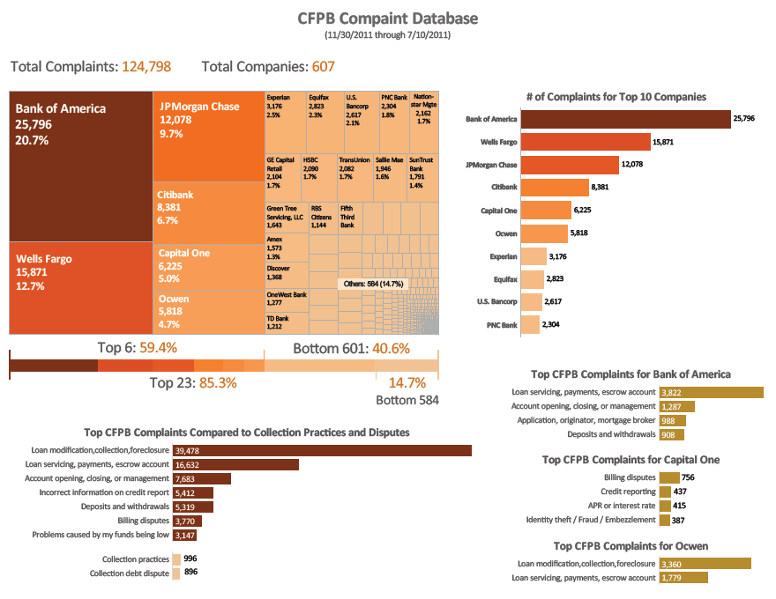
Source: https://www.dataplusscience.com/BankSentiment.html
Notes:
Treemaps can also be useful for categorical comparisons without hierarchy. In this case, there are 607 companies with 124k complaints. The treemap allows use to show them all in one view and make relative comparisons. As with the software vendors, we could show the top 10 as a bar chart, which is useful because that represents 70% of the total data. However, the top 10 would not be useful for Fifth Third Bank if they wanted to know where they rank against the other banks because they are #19. Using the treemap with interactive features, such as a dropdown box to highlight a certain bank or to hover for a tooltip, allows for a deeper analysis in this case.

Slide 51
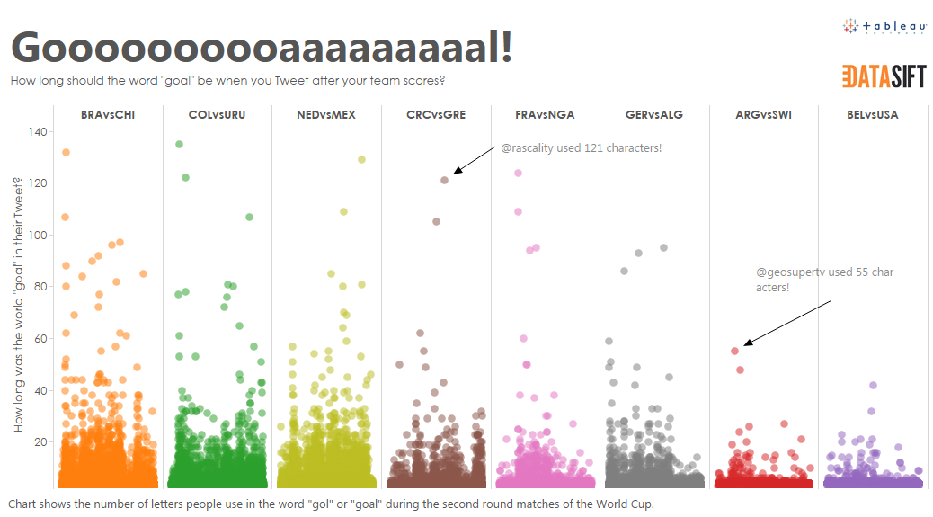
Source: http://tabsoft.co/2u4WUyU
Notes:
Another way to show lots of points is a dot plot, or strip plot, with jitter. Andy Cotgreave shows the Tweets with the word “Goal” during the World Cup games. During the USA game, the number of characters used to spell goal was very low, topping out at just over 40, but in the Brazil game we see that someone tweeted out Goal using almost 140 characters for that single word.

Slide 52
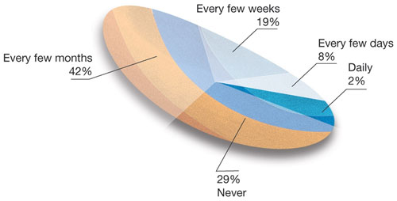
Source: https://eagereyes.org/criticism/march-chart-madness
Notes:
This one might get runner up as the worst pie chart ever done. In this case, the slices aren’t even angles of the pie chart, but are sliced in banana shapes across the pie chart.
This chart supposedly shows how often people make online recommendations., but that doesn’t matter much since the chart doesn’t convey the information in any graphical manner that is useful. Let’s walk through a redesign process on this chart.

Slide 53
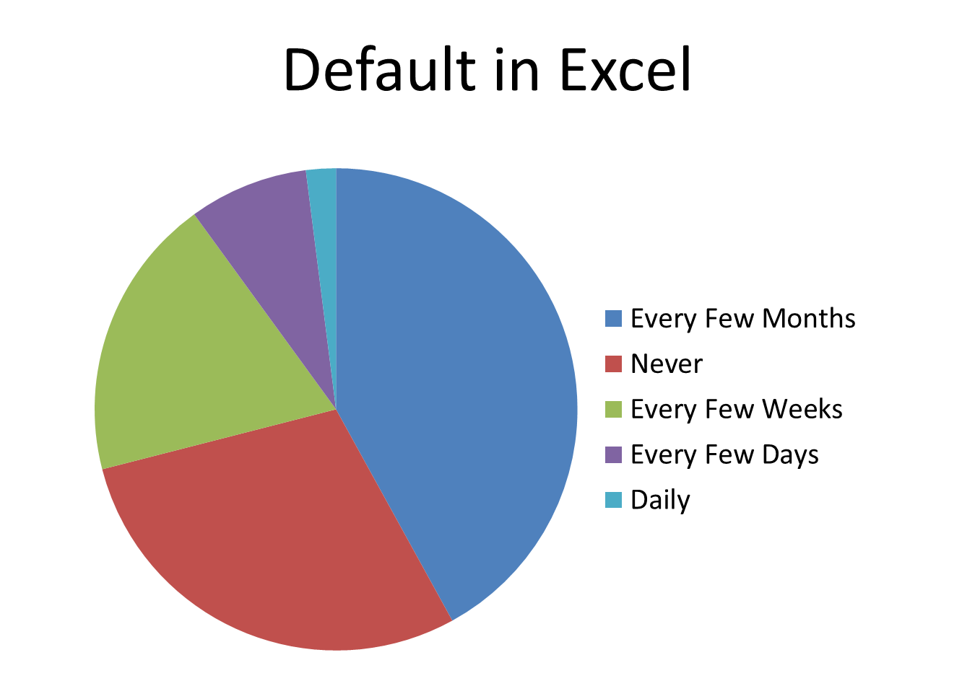
Notes:
If we plot this in Excel, this is what it would look like by default.

Slide 54
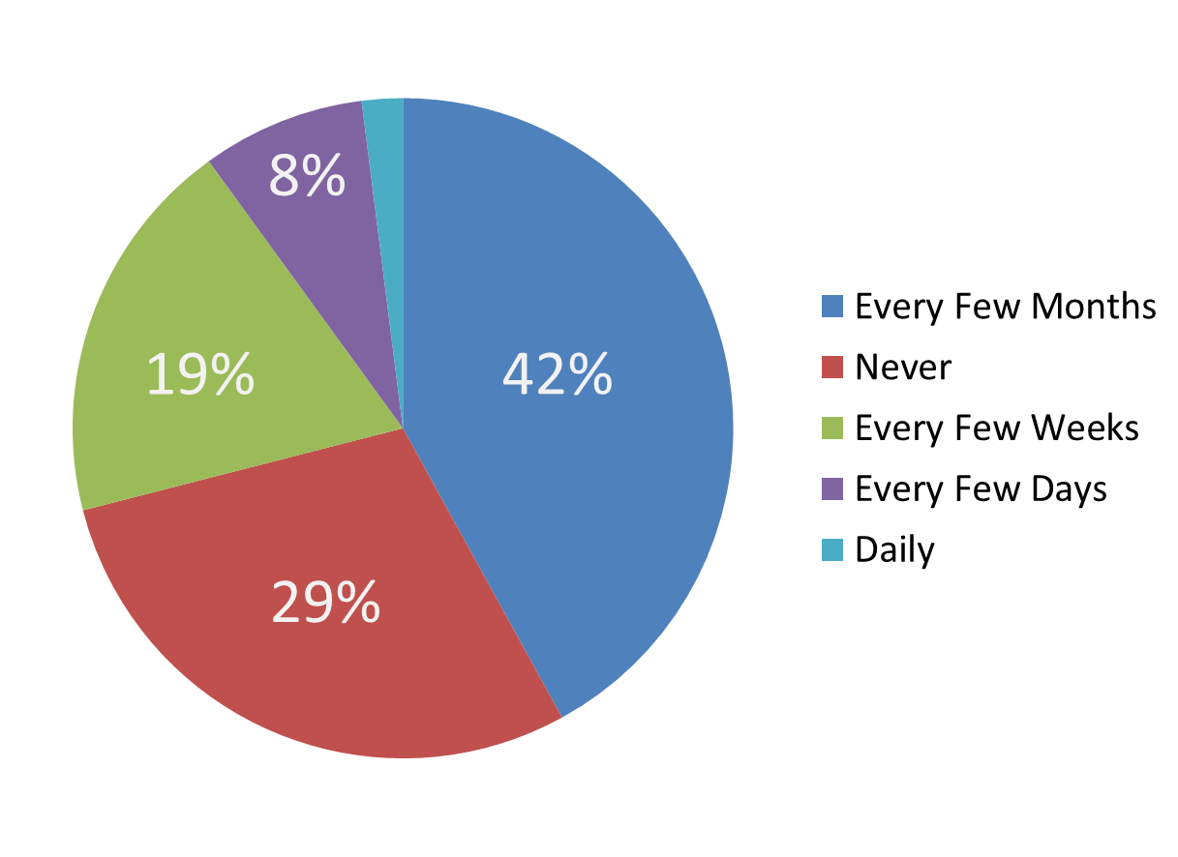
Notes:
We can add data labels to make it a bit more useful, but now that we’ve learned that pie charts aren’t great for comparison let’s look at some other options.

Slide 55
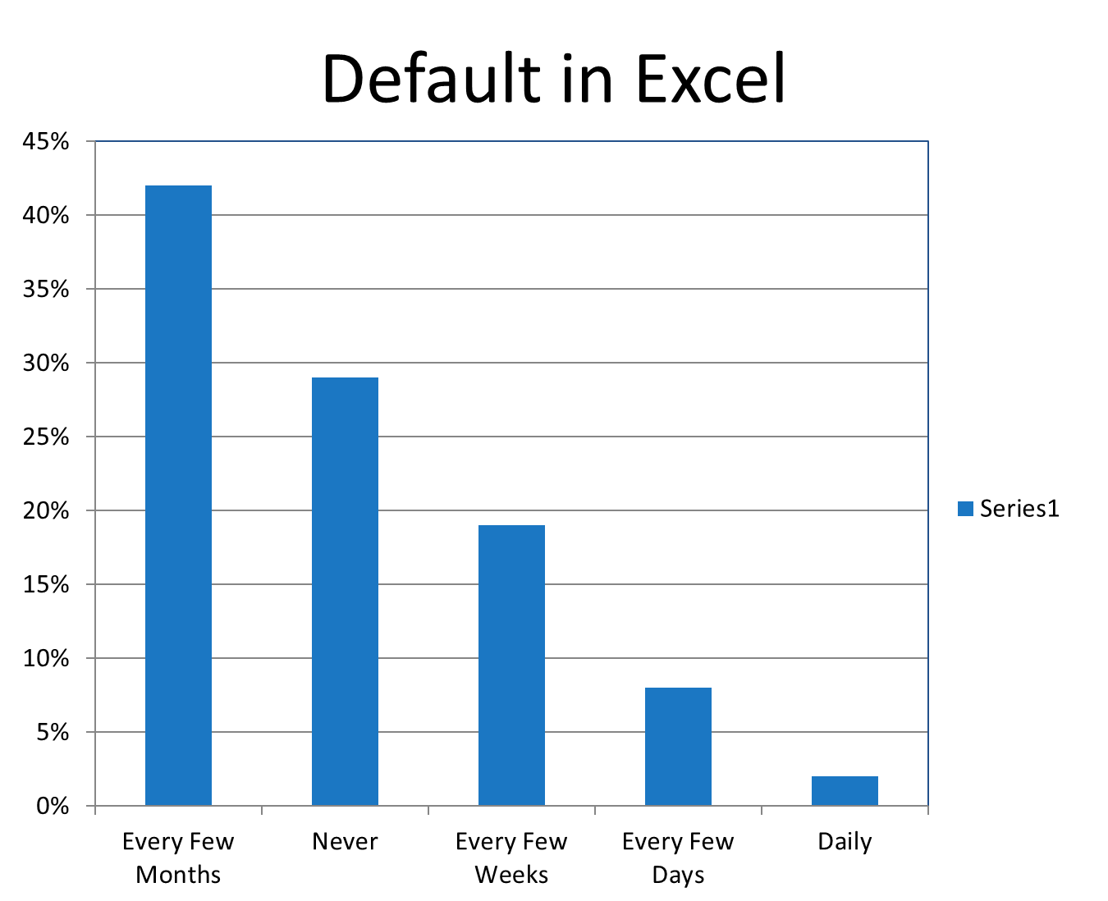
Notes:
This is the default bar chart in Excel. Notice the increments of the y-axis by default and the name on the color legend, “Series 1”, which isn’t useful.

Slide 56
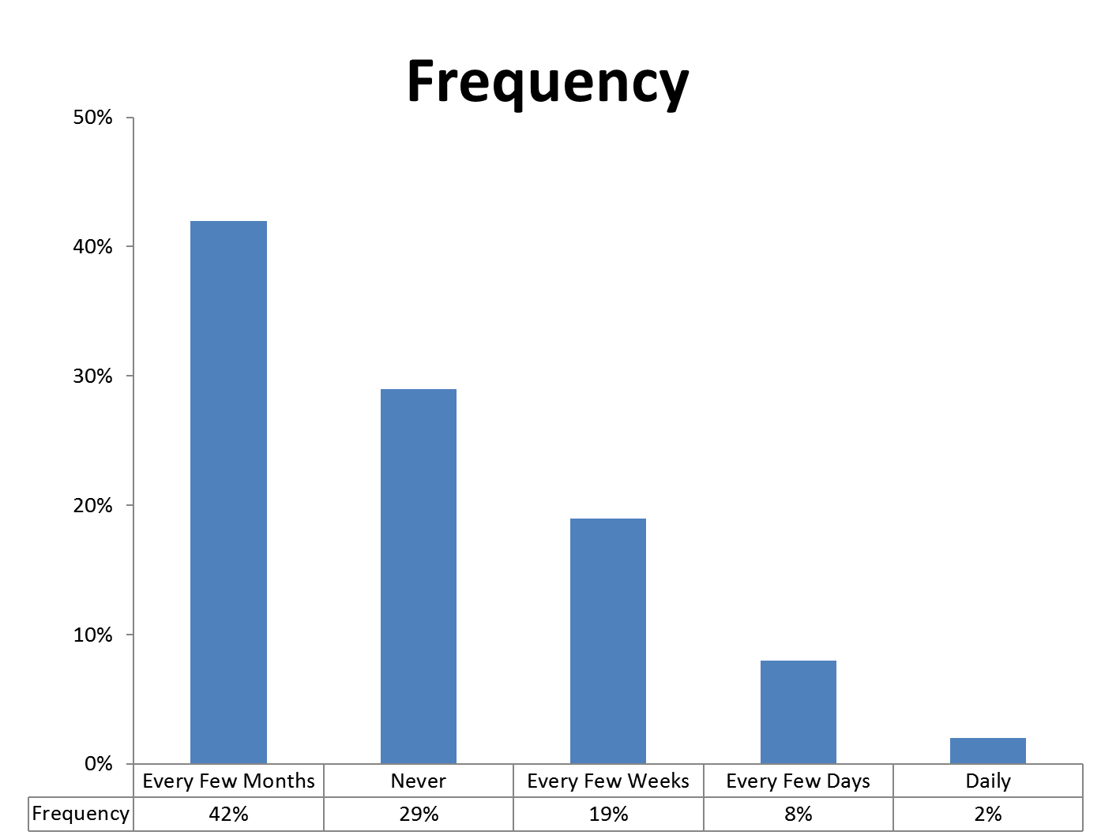
Notes:
We can clean this up a bit and add a data table in Excel.

Slide 57
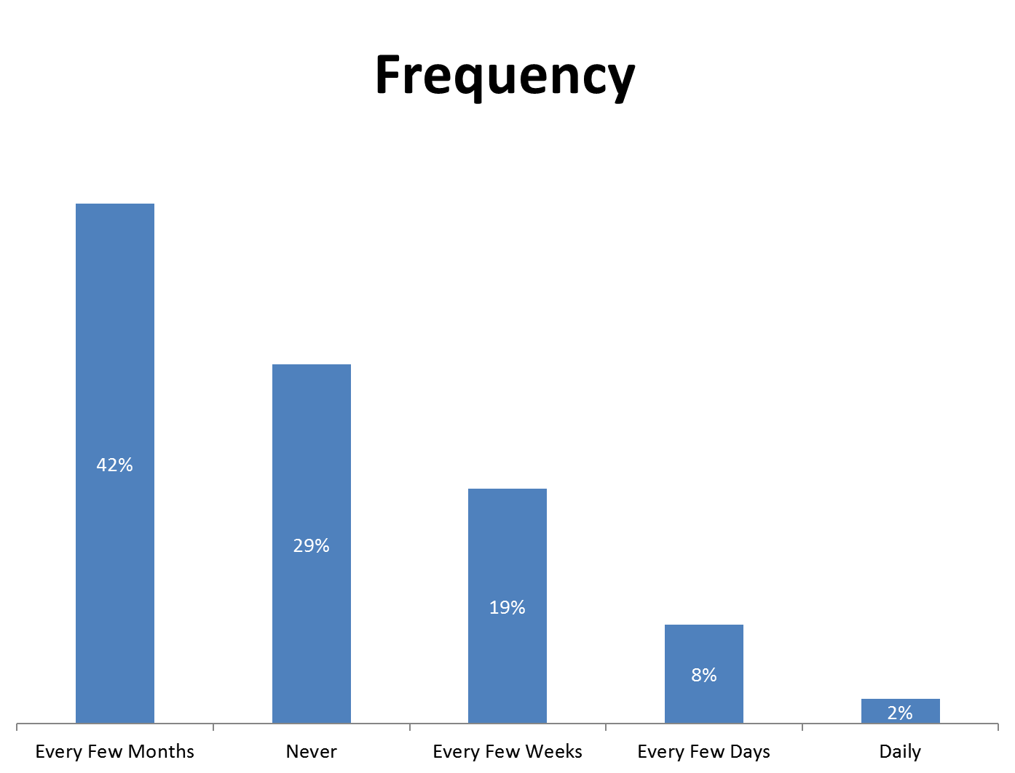
Notes:
We can remove the y-axis and data table and label the bars directly.

Slide 58
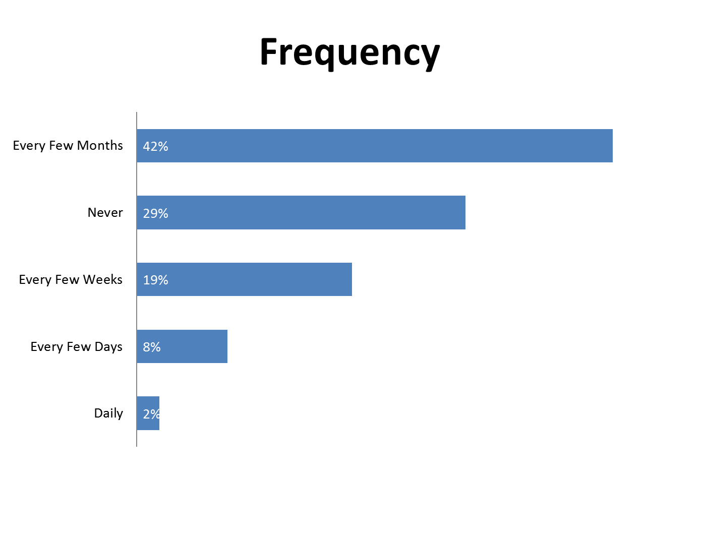
Notes:
And we can rotate the chart, which can be very useful when there are longer labels so we can avoid rotated text. This makes it really easy to read and make an easy comparison.

Slide 59
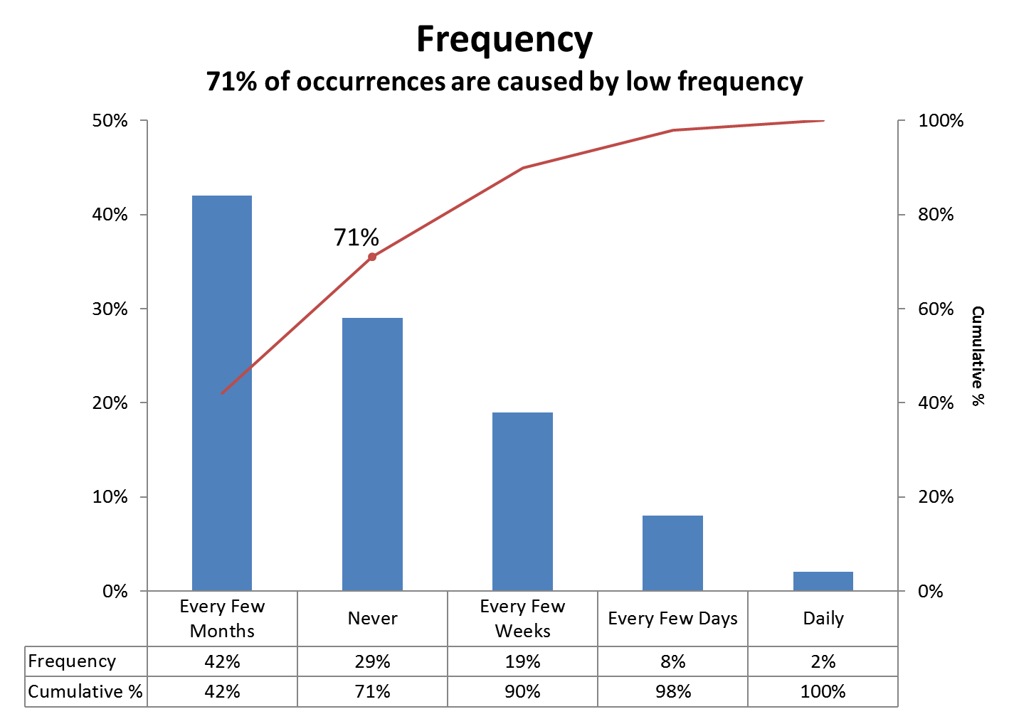
Notes:
This is a different view of that same data. This is called a Pareto Chart. Vilfredo Pareto was an Italian Economist and Mathematician and he figured out that 80% of Italian real estate was owned by 20% of the people. This is often referred to as the Pareto Principle or the 80/20 rule. The chart plots the cumulative percent with each category. Note that the numbers won’t typically come out to exactly 80% and 20% as it did for Pareto, but it can be a very useful chart for determining the cause for a problem. In this case 71% of the occurrences are happening Every Few Months or Never. In the treemap of the complaints data we say 6 companies out of 607 representing 60% of the total complaints.
There are typically two ways that people plot Pareto charts. It has to do with the scale of the primary y-axis. In this case the y-axis plots from 0% to 50%. The advantage of this is that the bars can extend up to the top range of the data, but the line is plotted in the middle of the first bar.

Slide 60
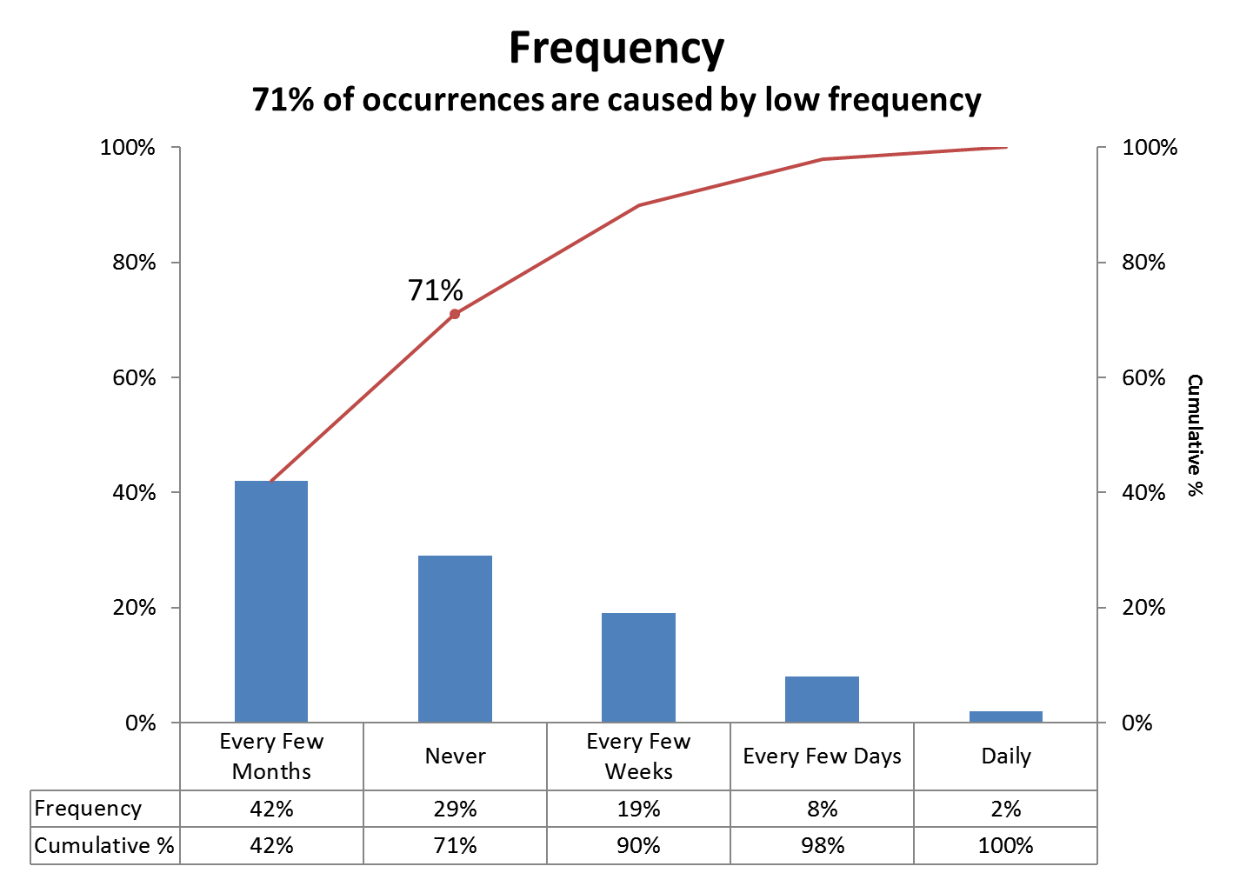
Notes:
As an alternative, if the y-axis is synchronized, the line extends from the top of the bar chart. However, notice that the bars are now compressed lower to the x-axis. This isn’t really a problem with this data, but it could be an issue when there are a number of low value bars that would be difficult to compare.

Slide 61
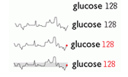
Sparklines
Invented by Edward Tufte
Notes:
Sparklines were invented by Edward Tufte (TUFT- TEE). They are basically a line chart that has been stripped down to just the line and made into a small, word-sized graphic. They aren’t meant to be used as an alternative for a line chart. They were designed to bring additional context to numbers. This example comes from Edward Tufte’s book, The Quantitative Display of Information. The first line shows glucose is 128. In approximately the same amount of space that it takes to write “glucose 128”, we can now see the trend leading up to the current glucose level. The third line is just a style difference, coloring the dot red with the glucose number. The last line has additional context added, a performance band has been added that is colored gray so that we can see the expected range. We now can see numbers that were out of range, both below and above the band. We don’t know the time frame of this line or the scale, but that’s not the purpose. What we can see is where the number came from, that it came up from a number that was below 128 and that it was really high prior to that.

Slide 62
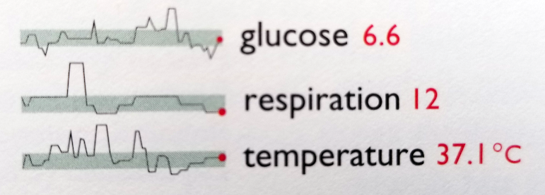
Sparklines
Small, high-resolution graphics embedded in a context of words, numbers, images. Sparklines are data-intense, design-simple, word-sized graphics.
Notes:
We can then place a number of them together and see the interactions between them. For example, we can see that after respiration was really high, it was then followed with a really high temperature followed by glucose. Sparklines can be very useful, especially in a small space.

Slide 63
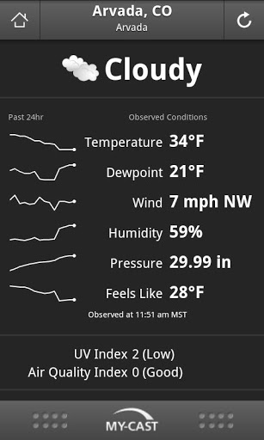
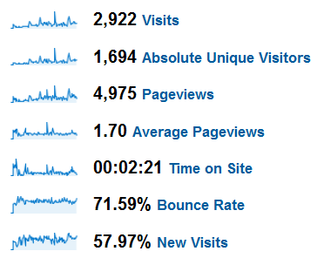
Sparklines
Source: https://bestmobileappawards.com/app-submission/my-cast-weather
Notes:
We see sparklines on Google Analytics (on the left side) and an example weather app on a smart phone. It doesn’t get much smaller than a phone, other than maybe the Apple Watch. Notice the additional context shown by the sparklines. We see the temperature is 34 degrees on the right, but the sparkline shows the trend of the temperature for the last 24 hours. We can now wee that it was much warmer early and that it dropped down to 34 degrees. We don’t know what the high temperature was in this view, but it does show trends for 6 different weather numbers over the last 24 hours.

Slide 64
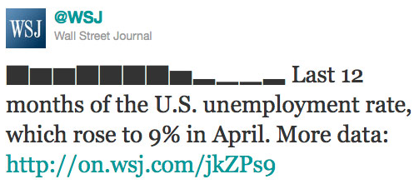
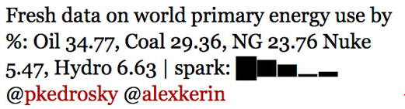

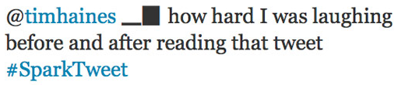
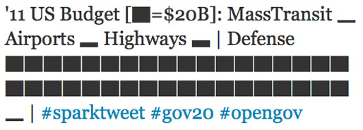
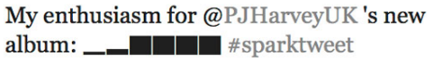
Sparktweets
Notes:
In addition to sparklines, there are other variations. For example sparkbars. We can even find sparktweets, where people have encoded data directly into their tweets.

Slide 65
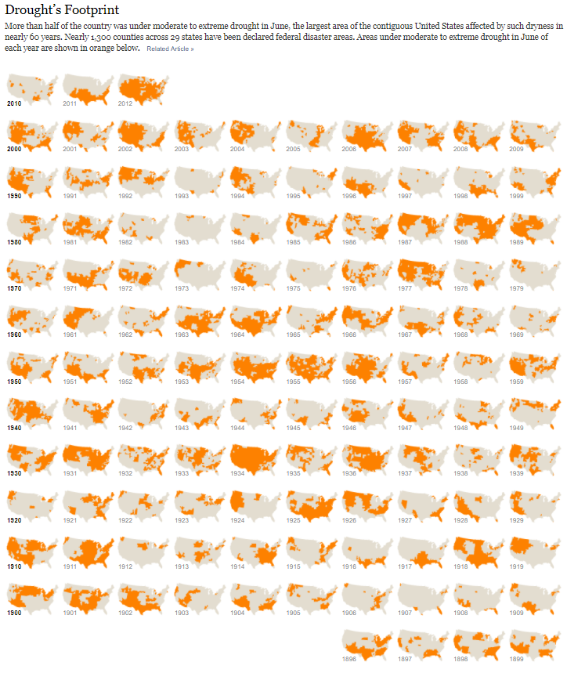
Small Multiples
Invented by Edward Tufte
"Illustrations of postage-stamp size are indexed by category or a label, sequenced over time like the frames of a movie, or ordered by a quantitative variable not used in the single image itself."
Source: http://www.nytimes.com/interactive/2012/07/20/us/drought-footprint.html
Notes:
Bill Cleveland created trellis charts, but Edward Tufte broadened the use and called them small multiples. These can be any series of small charts for comparison. Bar chart, bar chart, bar chart, or in this case a series of maps showing the footprint of droughts in the United States by year. On one page the New York Times visualized over a century of droughts on a single page.

Slide 66
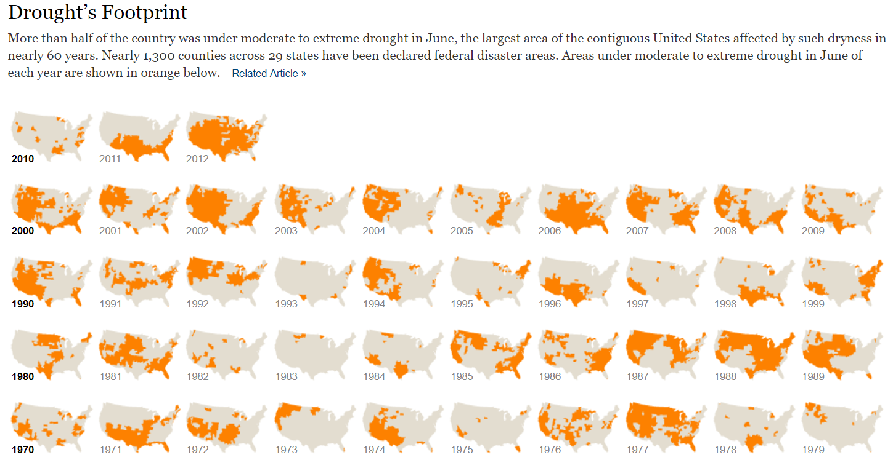
Source: http://www.nytimes.com/interactive/2012/07/20/us/drought-footprint.html

Slide 67
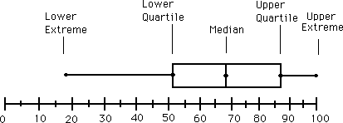
Box and Whiskers or Box Plot (Tukey):
Notes:
The box plot was invented by John Tukey, who is the father of Exploratory Data Analysis. The box and whisker is used to show a distribution of an entire set of data. That’s the strength of the box plot, in that it can show all of the data. It doesn’t matter if it’s 7 billion on the planet, or 10,000 conference attendees. It would be impossible to show those kinds of numbers with dots without significant overlap and an unwieldly number of marks. The box plots aggregates and summarizes this data. Typically they are shown with the 25th and 75th percentiles or 1.5 IQR. It’s not critical to understand how to calculate these since most visualization software will calculate these for you.

Slide 68
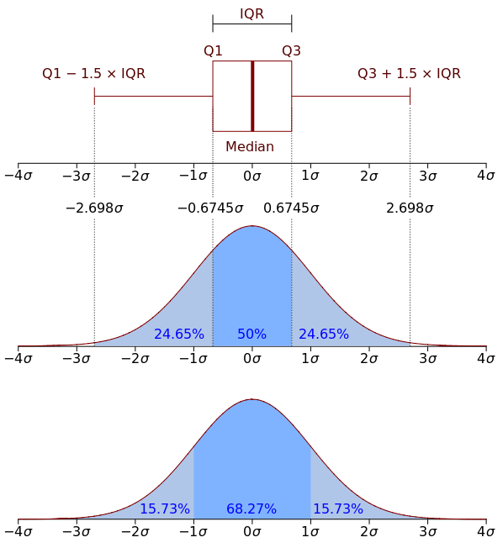
Box Plot vs. PDF
Source: https://en.wikipedia.org/wiki/Probability_density_function#/media/File:Boxplot_vs_PDF.svg
Notes:
The box plot may not be the easiest thing for the reader to understand. If the visualization is for the general public, then it might be better to avoid the box plot, or at the very least, make sure there is a great “how to read this chart section”.
This image shows the relationship between the box plot and the Probability Densify Function.

Slide 69
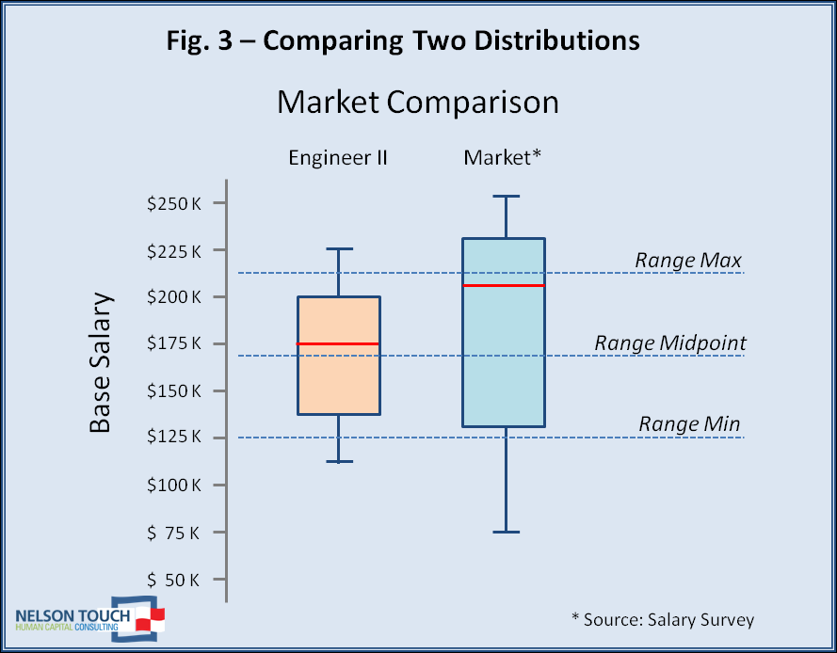
Notes:
Another advantage of the box plot is that it uses the preattentive attribute of position for the primary comparison. Because of this, the box plot does not need to have an axis that starts at zero and like the bar chart, it can be rotated vertically or horizontally.

Slide 70
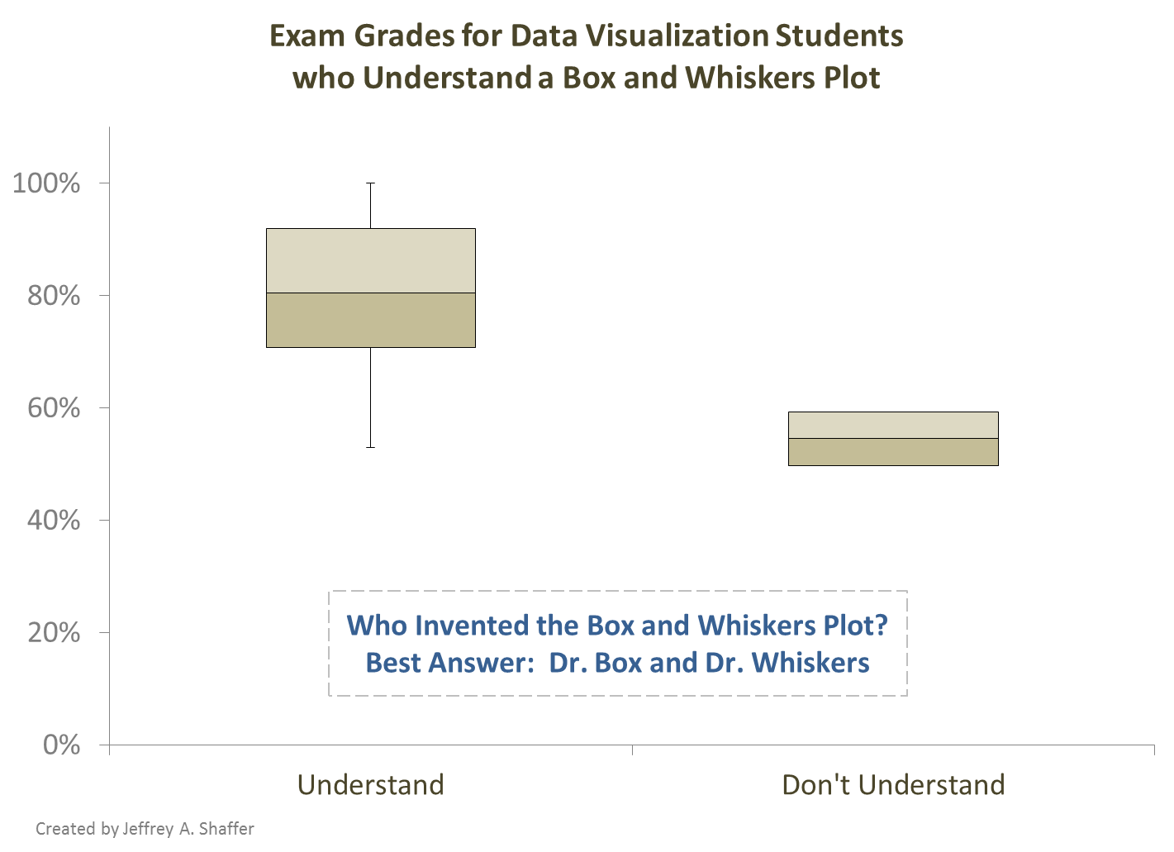
X

Slide 71
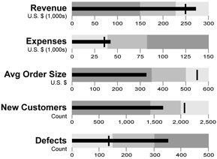
Bullet Graph (invented by Stephen Few)
Source: Public Domain
https://en.wikipedia.org/wiki/Bullet_graph#/media/File:Bullet_graphs_multiple.png
Notes:
Like the sparklines, these can be used in a very compact space to show context of an actual number compared to a target number. They can also be combined to show comparisons across categories or within a category. Because they encode using length of the bar and position of the target line, they can extend beyond their current value and so they are not bounded by some upper end, like a donut chart or gauge chart would be.

Slide 72
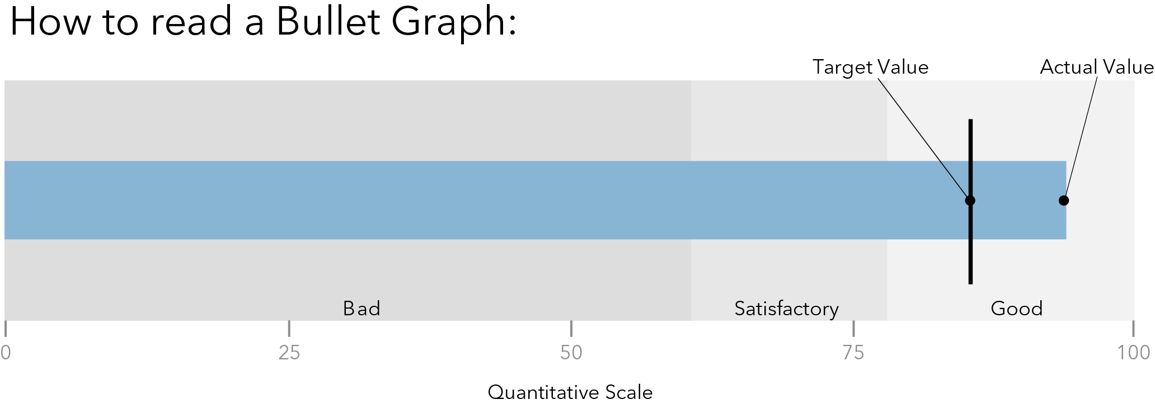
Source: The Big Book of Dashboards (Figure 1.36)
Source: The Big Book of Dashboards (Figure 1.36)
Notes:
The blue bar in this bullet chart represents the actual value and the back line shows the target for that number. It’s easy to see exactly where the actual value is compared to the target value. The shaded areas represent performance bands. Dark gray for bad, a medium gray for satisfactory and the light gray for good. We know immediately the the light gray is “Good” because this is the area on the chart where the target line is, but not the target line could also be reversed, showing “lower is better”, for example, the target would be set lower for defects or expenses.

Slide 73
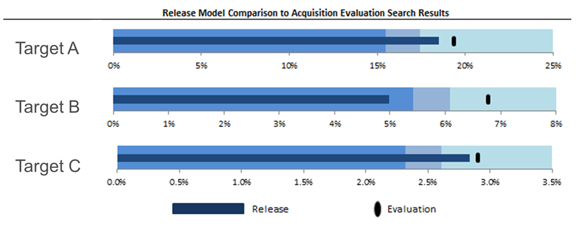
Bullet Graph (invented by Stephen Few)
Notes:
Bullet charts are native in Tableau. They can also be created in Excel, but they are not easy. This example was created in Excel and shows 3 targets.

Slide 74
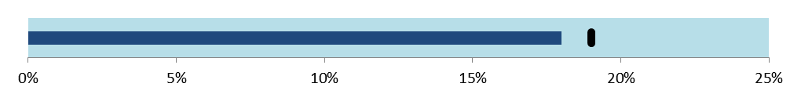
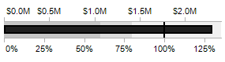
Variations on the Bullet Chart
Remove performance bands
Just actual to target
Easier to understand
Dual axis Bullet Graph
Shows both value and %
Notes:
Users may not immediately understand the bullet chart and there may not be a need for the performance bands. You may find that by removing the performance bands that the bullet chart is easier for readers to immediately understand and interpret. The bullet chart on the top simply shows an actual bar versus the target line, similar to what a thermometer might show.
The bottom example is a variation created by Jeff Shaffer, which is a dual-axis bullet chart created in Tableau. This shows both the percentage and the actual values.

Slide 75
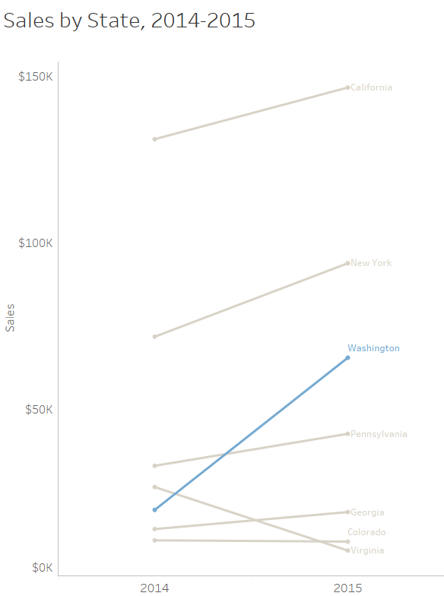
Slopegraph
Source: The Big Book of Dashboards (Figure 1.21)
Notes:
A slopegraph can be a very useful chart to show the trend of two different time periods.

Slide 76
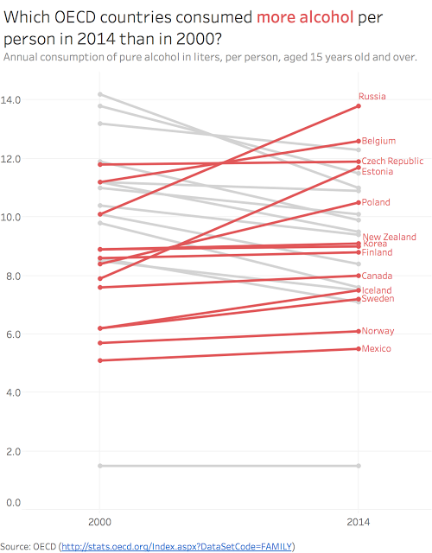
Notes:
This Slopegraph created by Andy Kriebel shows alcohol consumption for the OECD countries comparing 2000 to 2014. The color red highlights countries that increased their alcohol consumption and the gray lines decreased.

Slide 77

Notes:
While slopegraphs typically show two points in time, but this visualization created by Andy Kriebel uses a Slopegraph to show predicted vs. actual wins of NFL football teams.
Source: Tableau Public
https://public.tableau.com/profile/andy.kriebel#!/vizhome/NFL2014WinsvsPredicted/NFL

